Slide 1
Chillomania’s SEO Strategy
Saran, Pedro, Anokhi & Ricardo

Slide 2
Goals for Chillomania’s website
Short term goals
Drive organic traffic into the website.
Website should come in first page of Google listings in a month.
Long term goals
Drive more traffic, increase the conversion rates and increase ROI.

Slide 3
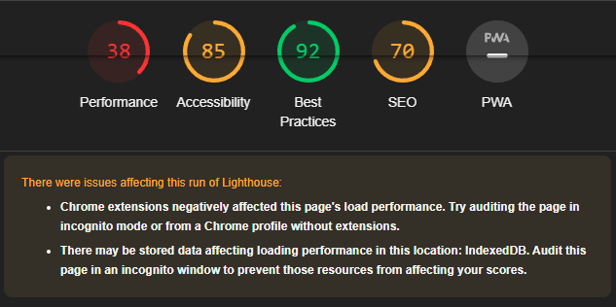
Diagnostic of chillomania’s website
Low performance: 38
Images optimizations
Page not responsive on mobile device
Create XML sitemap and submit to search engines

Slide 4
Technical SEO
Optimize website speed and performance
Create XML sitemap and submit to search engines
Ensure mobile responsiveness
Check for broken links and fix them
Generate robot.txt
Use header tags correctly
Implement AMP for mobile users
Integrate and Build a GA dashboard for the monitoring and tracking.

Slide 5
Content SEO
Conduct keyword research and use them appropriately
Create unique, high-quality content
Optimize meta title and description tags
Use internal linking to establish site architecture
Incorporate multimedia content
Update content regularly
Blog optimization

Slide 6
Off-page SEO
Create and verify Google My Business profile
Leverage social media presence
Guest post on relevant sites
Participate in online forums and communities
Submit website to relevant directories

Slide 7







Tools

Slide 8
Conclusion
Prioritize technical SEO tasks such as optimizing website speed and ensuring mobile responsiveness and search engines indexing/ranking.
Conduct keyword research and create unique, high-quality content for effective content SEO.
Build a strong online presence through Google My Business, social media, and guest posting.
Regularly update website content and participate in online communities to improve SEO performance.
Monitor the bounce rate, Monitor demography and users behaviours.

Slide 9
Appendix
Our complete SEO check list for Chillomania’s website:
https://docs.google.com/spreadsheets/d/1boBQqESdIQ0mgc8OpgsCanmQFvi0nxY5ayyU4nfT9eM/edit?usp=sharing
Google’s guide to optimize a website for search engines:
https://support.google.com/webmasters/answer/9128678?hl=en

Slide 10
Thank You
Questions?

